Slide 1
HUMAN COMPUTER INTERACTION
Group Assignment Presenatation
Group Members
Bikash Baral(NPI000021)
Shivam Ranabhat(NPI000047)
Kapeel Pokhrel(NPI000030)
Saroj Kandel(NPI000043)

Slide 2
Introduction
Bright Future Web application is a system built for online learning. It will help the bright future education center to expand their business and make it more accessible to people through online medium. The web application will help the users to choose the kind of courses they want to study. It has features like user login, purchasing courses,reading blogs, About Us and Contact features.
The main objective of this web application is to develop a user interactive online learning system

Slide 3
User Profiling and Task Analysis
Bright Future web application was created by taking human computer interaction factors into consideration. The web application is related to education related stuffs and is developed for a educational education center based in Pokhara city of Nepal

Slide 4
User Profiling
Categories Of User | Users | Justification
Primary | Students, Office Goers and other kind of people interested in learning | Primary users are the individuals are directly affected by the actions of the organization.They are the people who use the facility provided by the system on daily basis.
Secondary | Administrator,working staff | Secondary users are the individuals are indirectly affected by the actions of the bright future education center .They are responsible for increasing the productivity of the project.
Tertiary | owner of the project | Tertiary users are the individuals are less affected than secondary stakeholders. These are the group of people whose opinions and perceptions can determine the success and failure of the system

Slide 5
Data Gathering and Analysis
Free format Questionnaire is selected as the data gathering technique for our bright future web application as it helps us to collect a large amount of data in small period of time. The method is cost effective and can be easily made and distributed online using google forms .We have not used Fixed format questionnaire as it limits the respondents' answers, and the respondents may not find the answer he/she wants to answer.

Slide 6
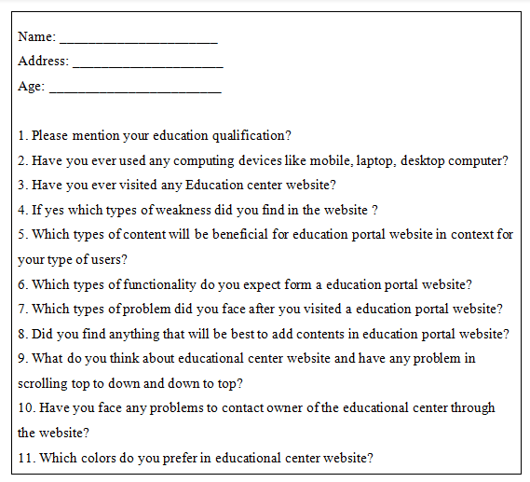
Questionnaire Sample

Slide 7
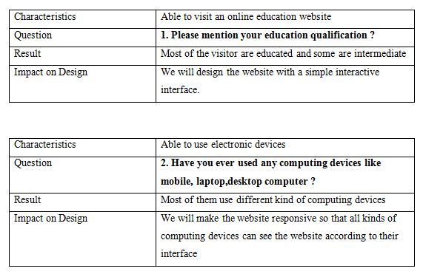
Questionnaire Analysis Samples From Documentation

Slide 8
User Profile
Characteristics of User
Description | Users who have a bank account
Age | 18 and above
User Type | Intermediate along with expert users
Gender | Male and female both
Country | Specifically for Nepal
Experience | Should have knowledge on how to use web applications

Slide 9
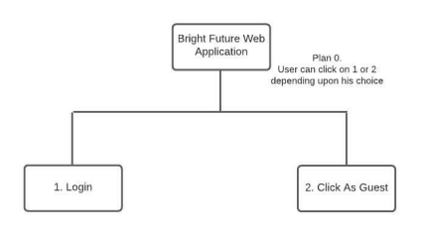
Task Analysis
User Entry Point into the system
 | Critically | Difficulty | Frequently
Login | H | L | M/L
Click As Guest | H | L | L

Slide 10
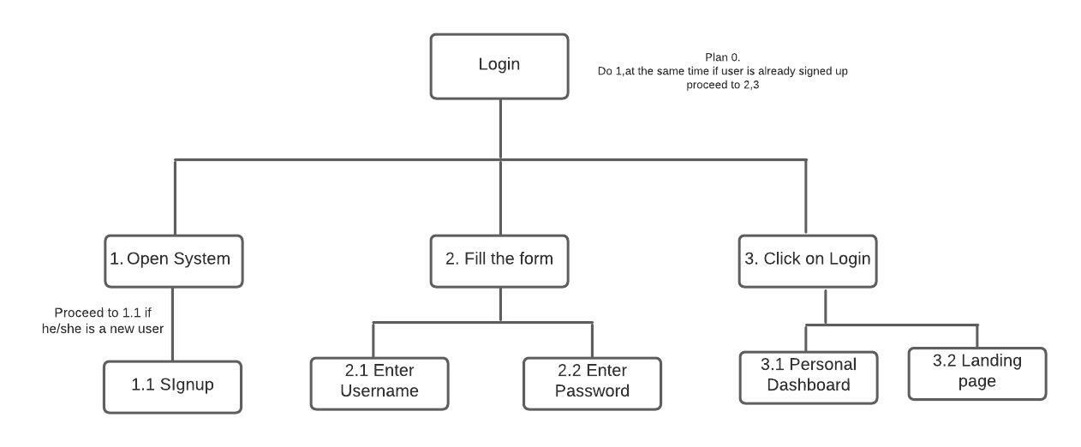
Login HTA
 | Critically | Difficulty | Frequently
Open System | H | L | M/L
Fill Form | H | L | M/L
Click On Login | H | L | M/L

Slide 11
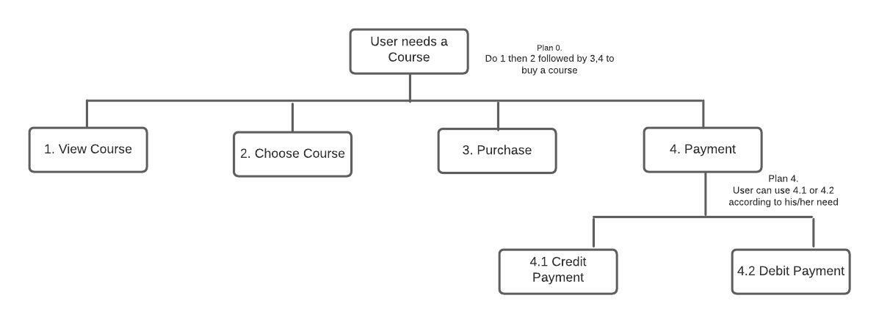
 | Critically | Difficulty | Frequently
View Course | H | L | H
Choose Course | H | L | H
Purchase | H | L | H
Payment | H | L | H
Courses HTA

Slide 12
Usability
Introduction
Quality of a user’s experience while interacting with the system.
Achieve specific goals with effectiveness, learnability, memorability, efficiency, and satisfaction through a system.
Method of improving ease of use during the design process.
Determines the rate of success or failure of a system

Slide 13
Selection of usability goals
Learnability
Enables to become familiar within short period of time.
Goal of our system:
Ensure that it is easy to use and takes little time to perform specific tasks.
Efficiency
Resources used by the user for the accuracy and completeness to achieve a goal
Goal of our system:
Able to take benefits from the services which our company will provide

Slide 14
Memorability
Ability to recall or remember the learning of a system.
Goal of our system
Easy to recall the system even if a user gets back after a long period.
Error
Being away from being in an undesirable condition while using a system.
Goal of our system
Avoid any type of unintentional action while performing tasks through feedback
Satisfaction
Means how pleasant is the system to use.
Goal of our system
Provide the most enjoyable experience to the user

Slide 15
Design Principles
Consistency
Same font and color on every page
Position of a logo of our company will be consistent on all pages.
Mapping
Down arrow in navigation bar which display submenus downwards.
Constraint
Will restrict the user to register, log in, and submit their query without filling all the inputs available

Slide 16
Affordance
Icons in the service section will be used which have real life meaning.
Shape and color of the button which will denote it as a button.
Feedback
Notification displayed after placing an order
In login or registration form if any field will be missing
Visibility
color of fonts and the background will be visible enough
Only most important functions will be arranged in the main menu bars

Slide 17
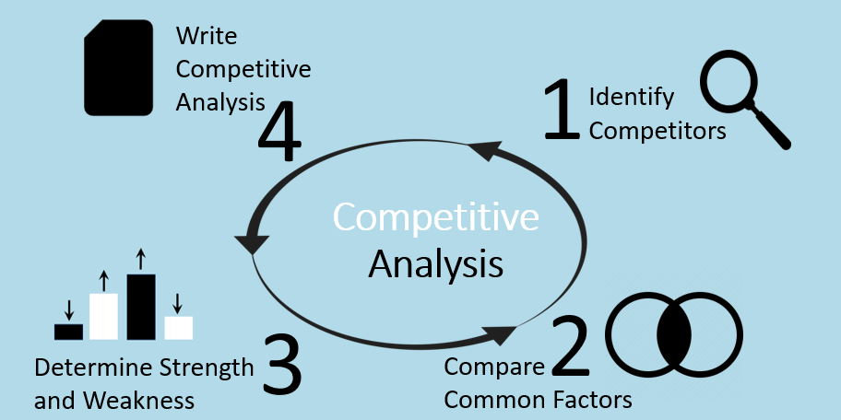
Competitive Analysis
Studying competitors through gathering insights and their market strategies
Helps to know the actual strength and weaknesses of the competitors
Helps to identify how they are overcoming or lacking behind.

Slide 18
Criteria | Bright Future | MPX Interactive | EDX
Visibility | Good visibility due to the perfect use of text and background color and important features in the main menu bar. | Good visibility due to important features arranged in the navigation bar. | Good visibility due to the text and background color.
Constraints | All the details must be provided in every form to perform the further tasks. | Similarly, the restriction is available if any input field is empty. | Lack of constraints due to the absence of restriction in the contact form for the message field.
Feedback | Proper feedback is provided after every operation which is done successfully or any errors occurred. | Feedback is provided only in the login and registration form. | Lack of feedback in the contact form by which the user can send an empty message.
Consistency | All the text sizes, colors, and positions of every element are consistent on every page. | Inconsistent due to a mess of information on the course page while providing the details of a particular course | Consistent due to the proper size and arrangement of the elements on every page.
Mapping | Good mapping due to the proper use of the down arrow to display the sub-menus and labels are arranged based on real-word scenarios i.e., first name before the last name in the registration form. | Mapping is used only in a few pages. | Use of mapping doesn’t found properly.
Affordance | Use of real-world scenario-based icons to define the purpose to the user by observing the icons only. | No use of any icons. | The use of icons is rarely found with no meanings.
Comparison table of Competitive Analysis

Slide 19
Analysis
Use of icons should be clear in every pages
Feedback should be properly given in every form to avoid errors
Notify the user of what has been done
Simple and attractive interface to increase user’s satisfaction

Slide 20
Prototype and Walkthrough
The Student Web Application of Bright Future is designed in a UX prototyping tool named Figma
It can be accessed by this link https://www.figma.com/downloads/.

Slide 21
Parallel Design
Parallel design is when many people work together to produce an early design from the same list of requirements.
A wide range of ideas that can be made quickly and cheaply is needed.
Multiple methods will be looked into at the same time, which will speed up the process of coming up with new ideas.

Slide 22
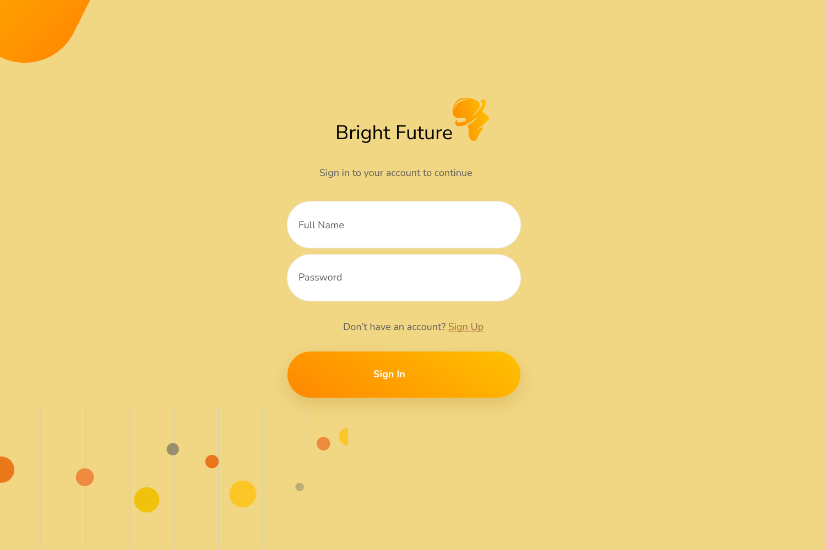
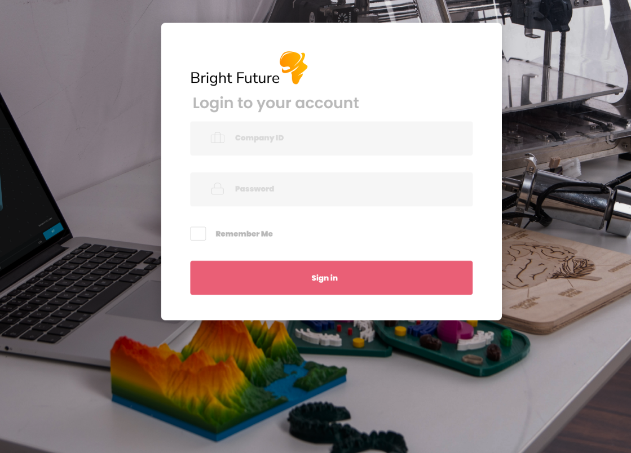
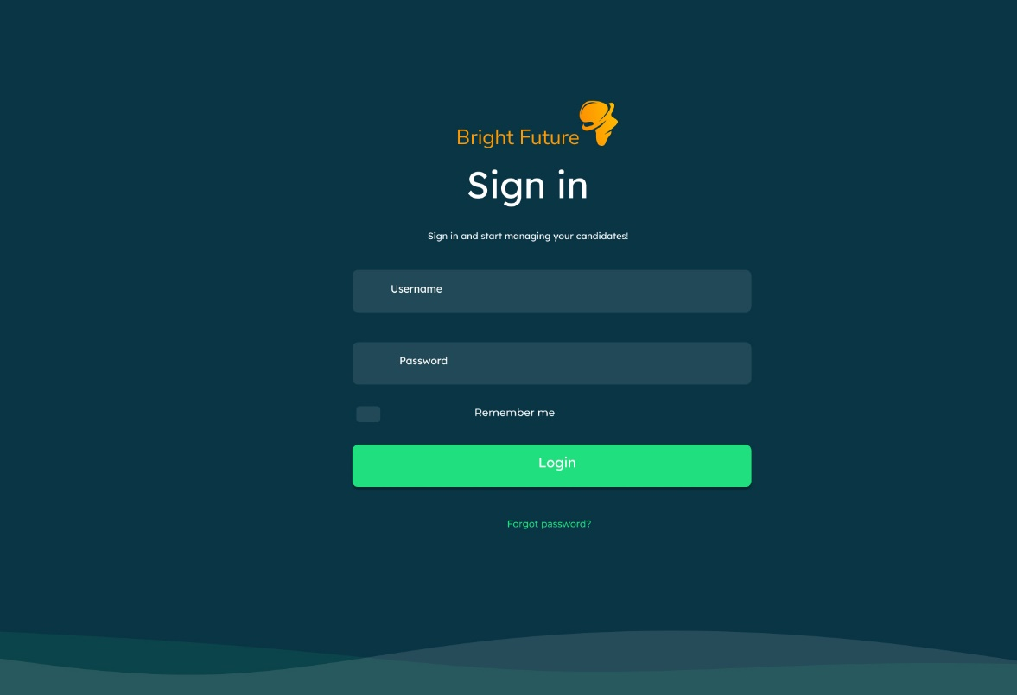

Slide 23
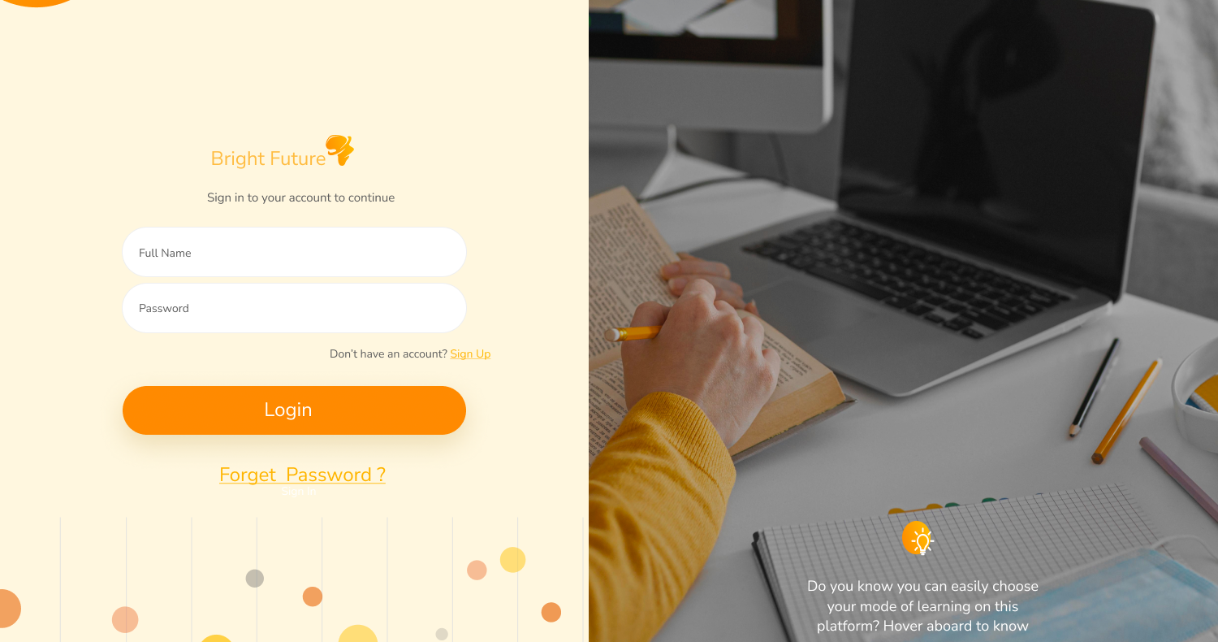
Final Design

Slide 24
Peer to Peer Evaluation
After analysis and discussing all the designs made by our group members, we all came to a conclusion to choose the fourth design by as the final Sign in Page design.
It is visually appealing and has better design strategies as compared to other designs, we have finalized it as the sign in page. This design has fulfilled all the design strategies i.e., Visibility, Affordances, Memorability, Mapping, etc. Also, the opacity level for background image and the card itself are giving attractive look to the design.

Slide 25
Card Sorting
Card sorting is a great way to get familiar with architecture of information and to consider all thevaluable insights that our web content should include. It is a low tech and affordable solution that can be carried out in plenty ways like pieces of papers, real cards or any online tools.

Slide 26
Card Sorting The diagram below is the initial stage of open card sorting of our purposed website

Slide 27
Card Listing

Slide 28
Card sorting by Category

Slide 29

Final Design
The Final Design is presented on Figma

Slide 30
Evaluation
The purpose of evaluation is to see if the software design meets the consumers needs, as well as the product’s mission and targets. The system’s usability for various user groups will be assessed during the evaluation phase. Furthermore, the benefits and drawbacks of design characteristics will be established in order to enhance design in the future.

Slide 31
Formative evaluation
Early in the development of a program, formative assessment is going to frequently conducted to inform providers and stakeholders about trends in results, whether the bright futures target is likely to be met, and to identify operational facilitators and barriers.
Results of the formative evaluation are then incorporated into the program with the necessary adjustments made to improve program implementation.
The formative evaluation’s findings are subsequently included into the program, along with any necessary revisions to improve program execution.

Slide 32
Usability testing
Usability is a quality metric that measures how simple it is to utilize a user interface. During the design process, the term usability also refers to strategies for enhancing ease-of-use.
There are five quality components that constitute usability these are learnability, efficiency, satisfaction, memorability and errors.
When users first use our website design, how simple is it for them to do fundamental task is tell us the learnability of the website.
How quickly can users accomplish activities after learning the design it defines the websites efficiency. How fast user can use it after a time of not using the bright futures website

Slide 33
Methods of usability testing
Lab usability testing
Unmoderated remote usability testing

Slide 34
DECIDE Framework
The DECIDE framework is a usability evaluation framework that acts as a step-by step guide for examining component of the product designs requirements.
2. It performs unit testing on all of the product’s elements in order to match requirements of the user and validate each and every unit of function.
Determine the goal (D).
explore the question
choose evaluations paradigm and activities (c)
identify the practical issue(I)
Decide how to deal with the ethical issues
Evaluate present interpret the data

Slide 35
Heuristic evaluation
Heuristic evaluation is a process where experts use rules of thumb to measure the usability of user interfaces in independent walkthroughs and report issues. Evaluators use established heuristics and reveal insights that can help design teams enhance product usability from early in development.

Slide 36
Usability Heuristics for User Interface Design
1: Visibility of system status
2: Match between system and the real world
3: User control and freedom
4: Consistency and standards
5: Error prevention
6: Recognition rather than recall
7: Flexibility and efficiency of use
8: Aesthetic and minimalist design
9: Help users recognize, diagnose, and recover from errors
10: Help and documentation

Slide 37
Conclusion
This project proposes a design for a web application for the bright future education center. The web application is designed to provide providing online learning learning services and built using asp.net.
The created system can help people who are interested in online learning, particularly students.
For our project, we have firstly indentified the problems and carried out different process such as user profiling,task and competitive analysis, prototype design, evaluation and many more to successfully develop and implement a web application for the education center following the design principles.

Slide 38

References
Benn, S., Abratt, R. and O’Leary, B., 2016. Defining and identifying stakeholders: Views from management and stakeholders. South African Journal of Business Management, 47(2), pp.1-11.
Righi, C., James, J., Beasley, M., Day, D., Fox, J. and Gieber, J., 2013. Card Sort Analysis BestPractices. Journal of Usability Studies, 8(3), pp.69-89.
Preece, J., Rogers, Y. and Sharp, H., 2002. Interaction design. New York, N.Y.: Wiley, pp.348-356.
Sajjad Kabir, S., 2016. Basic Guidelines for Research. 1st ed. [ebook] Chittagong - 4203Bangladesh: Book Zone Publication, pp.201-275. Available at:https://www.researchgate.net/publication/325846997_METHODS_OF_DATA_COLLECTION,[Accessed 1 February 2022].

Slide 39

Thank you

